Slide 1
Training for Urban Policymakers
Mainstreaming Climate Change into National Urban Policies in Asia and the Pacific
UN-Habitat
UNESCAP
www.fukuoka.unhabitat.org/cc_nup
Notes:
This training facilitates the practical application of the regional guide: “Climate Change and National Urban Policies in Asia and the Pacific”, which provides a framework for mainstreaming climate change into national-level urban-related policies in the Asia-Pacific region, as well as its accompanying online tools and references. All the material referenced in this training can be accessed at http://www.fukuoka.unhabitat.org/cc_nup.

Slide 2
Overview
Section 1 Overview of the Regional Guide: Climate Change and National Urban Policies in Asia and the Pacific
Section 2 Introduction to the Tools and Scenarios
Section 3 Next Steps
Notes:
The training has three sections. The first section provides an overview of the regional guide, explaining the background and mainstreaming framework introduced in the guide. The second section introduces the tools and scenarios associated with the guide that help to apply the framework to the user’s country context. The final section gives some brief next steps to consider when planning for and customising your mainstreaming process.

Slide 3
Section 1 – Overview of the Regional Guide: Climate Change and National Urban Policies in Asia and the Pacific

Slide 4
Purpose of the Guide
Mainstream climate change into existing National Urban Policy
Develop a new, climate-responsive National Urban Policy
Mainstream climate change into other national-level urban-related policies (e.g. national spatial framework, sectoral policies etc.)
Notes:
The regional guide has primarily been developed for national level government officers and other urban stakeholders that aim to mainstream climate change issues into their existing National Urban Policy. However, it can also be used to develop a new, climate-responsive National Urban Policy. Governments may also find this Guide useful to mainstream climate change issues into other national-level urban-related policies, such as national spatial frameworks and sectoral policies etc., which collectively may provide a framework for integrated urban development, thereby implicitly serving the function of a National Urban Policy.

Slide 5
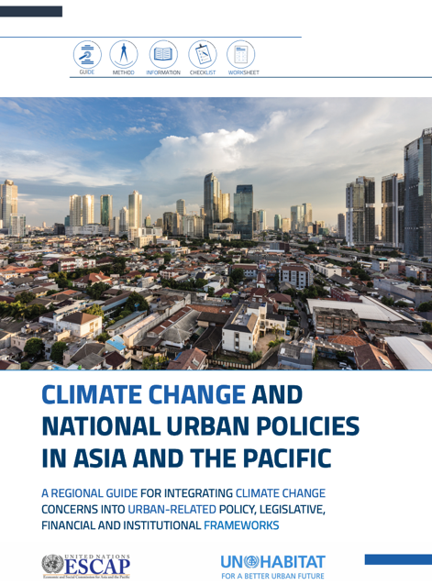
Regional Guide Structure
Section 1: Context
1.1 Urbanization and Climate Change in the Asia Pacific
1.2 Mainstreaming Climate Change Concerns
1.3 Urban and Climate-related Governance Frameworks
1.4 New Global Frameworks for Development Action
Section 2: Climate Change and National Urban Policy – A Mainstreaming Framework
Four Mainstreaming Phases
Four ‘Elements’
Section 3: Tools and References specifically prepared to accompany the Guide
Notes:
The regional guide has three sections.
The first section introduces the context in which the mainstreaming framework was developed - ranging from definitions and various forms of mainstreaming, regional urbanization and climate change trends, various forms of urban- and climate-related governance frameworks in the Asia-Pacific region, the relevance of National Urban Policies to climate change mainstreaming, and new global development frameworks that address urban issues and climate change in unison.
The second section introduces the mainstreaming framework itself. The framework adopts a flexible and non-prescriptive approach that outlines methods and steps for mainstreaming that countries can select based on their respective circumstances, under a framework of four “Phases” and four “Elements” that serve as the building blocks of the mainstreaming process.
The third section provides a brief summary of the tools and references specifically prepared to accompany the Guide – some of which will be introduced in the second half of this training.

Slide 6
Urbanisation and Climate Change in Asia and the Pacific
  Climate Change and Urbanization are two of the defining megatrends of our time
  The Asia-Pacific Region is extremely vulnerable to the impacts of climate change
  Cities are increasingly vulnerable to climate change
  Cities / Urbanization significantly contribute to the emission of greenhouse gases (40-80%)
Notes:
The next few slides introduce the context which corresponds to Section 1 of the regional guide, starting with Urbanization and Climate Change in the Asia Pacific.
Climate Change and Urbanization are two of the defining megatrends of our time. More than half of today’s global population lives in urban areas, and urbanisation projections indicate that this trend is set to continue over the next decades. Cities in Asia and the Pacific are at the heart of that global urban growth. Today they are home to 2.1 billion people and in less than two decades they are estimated to grow by another one billion.
Meanwhile, the Asia Pacific region is inherently exposed to climate-related natural disasters. The climate in the region has been changing - temperatures have been higher on average, and rainfall has been more variable and extreme. The region is further projected to face a wide range of climate change-related impacts, including warming temperatures, increased monsoon activity, rainfall variability, and more frequent and more intense cyclones and droughts in the coming decades.
The most far-reaching impacts of climate change on cities in the region are likely to be water-related, such as flooding and sea-level rise. Climate change will also intensify the urban heat island effect, in turn increasing energy demand and affecting air quality and human health. Increased heat and drought will also have significant impacts in Central Asian cities and towns, causing water shortages and affecting hydropower outputs.
Rapid, inequitable and unplanned urban growth in many developing countries in the region has led to the emergence of highly vulnerable urban communities, particularly those living in informal settlements. Given the deprived living conditions, the urban poor are more susceptible to climate-related risks, which have increased the likelihood of frequent and severe flooding, made worse by urban issues such as land subsidence and poor drainage.
Cities also significantly contribute to climate change. While they occupy only three per cent of the earth’s surface, they are responsible for 78 per cent of global energy consumption, and the production of 70 per cent of energy related greenhouse gas emissions (UN-Habitat, 2017).
Cities in the Asia Pacific region are projected to contribute more than half the rise in global greenhouse gas emissions over the next 20 years if no action is taken (UN ESCAP, 2017). As major contributors to greenhouse gas emissions, many opportunities exist to lower GHG emissions in cities, starting from the way in which cities are planned and designed. For example, compact or nodal cities with a variety of public transport and mixed-use neighbourhoods can save significant amounts of energy in the transport sector, and the way in which buildings are designed, constructed and operated is also critical for low-carbon development.

Slide 7
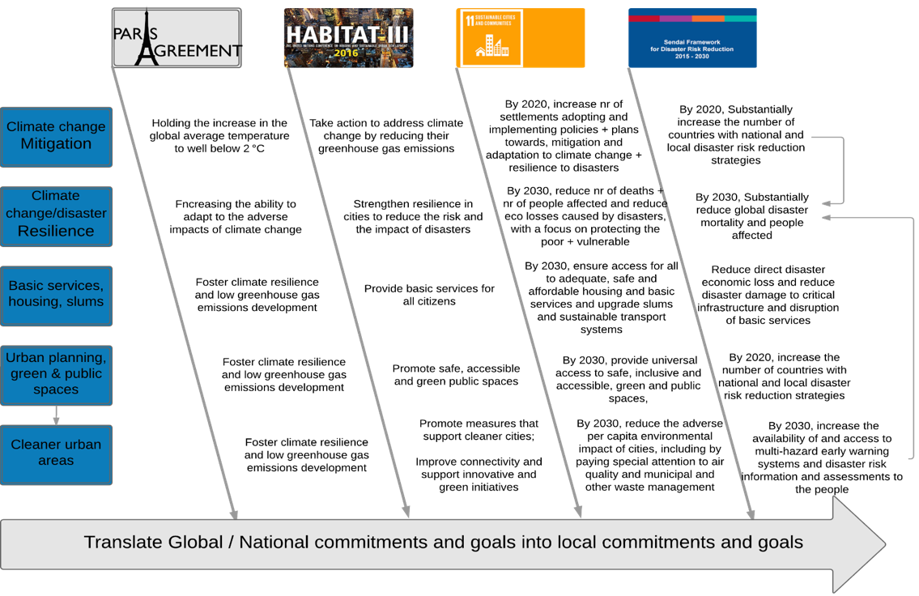
International Frameworks
Global frameworks already consider climate change and urbanization together
Notes:
Meanwhile on the global development agenda, there is a growing consensus that urbanization and climate change are addressed in unison. This is reflected in recent international frameworks such as the 2030 Agenda for Sustainable Development, the Paris Agreement, the New Urban Agenda and the Sendai Framework for Disaster Risk Reduction.
The International Frameworks Tool – Information Sheet lists the provisions in these major global frameworks that address climate change and urban issues together and provides information on the respective implementation and reporting mechanisms of the frameworks in detail. The regional guide also provides a summary.

Slide 8
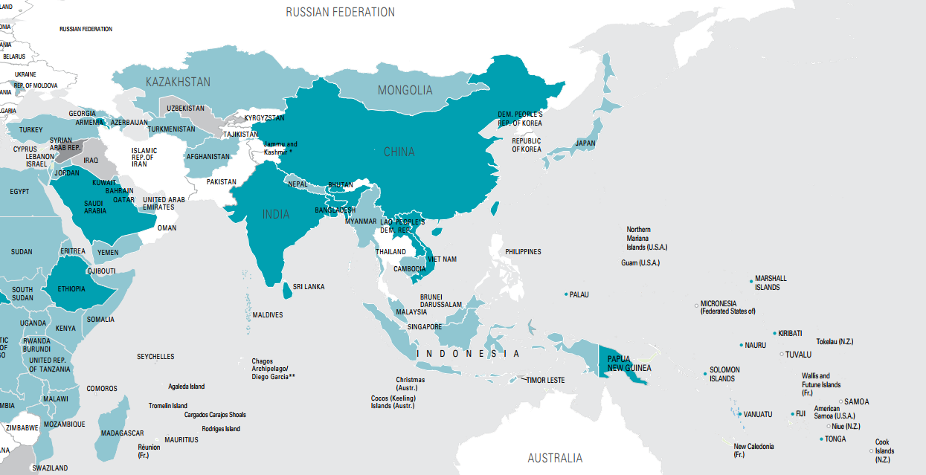
NDCs with urban-related targets
Notes:
As seen in many countries of Asia and the Pacific, urban and urban-related issues are a priority under the Nationally Determined Contributions (NDCs) which countries commit to when they ratify the Paris Agreement. This means that strategies need to be developed to implement adaptation and mitigation measures in cities.

Slide 9
Governance Frameworks and National Urban Policy
Types and state of urban policy development vary widely across the region
Importance of effective multi-level governance for mainstreaming
Notes:
Urban and climate related governance frameworks across Asia and the Pacific vary widely, with different countries having different types of policy, institutions, legislation and financing mechanisms. Therefore, the state and form of national-level urban-related policies also vary widely. Some countries have already thoroughly mainstreamed climate change considerations into their urban-related policies, while others may have only started the process.
Multi-level governance provides opportunity for consultation with lower levels of government and their participation in the policymaking process in order to understand the climate change issues that they are facing, enabling policy development that is context-specific. However, when decentralization is incomplete or multi-level governance mandates are not clearly defined, sub-national levels of government may lack the institutional, human and financial capacities to support policy implementation, possibly resulting in serious implementation gaps and policy failures.
Therefore, regardless of where a country is in urban policy development, institutionally and practically strengthening multi-level governance frameworks, and where appropriate, clarification and devolution of functions, responsibilities and funds are important for the effective mainstreaming of climate change concerns into urban policies. It is equally important for the successful implementation of the mainstreamed climate actions.

Slide 10
Definition of National Urban Policy
“a coherent set of decisions derived through a deliberate government-led process of coordinating and rallying various actors for a common vision and goal that will promote more transformative, productive, inclusive and resilient urban development for the long term.” (UN-Habitat)
Notes:
National Urban Policies are a key entry point for this integrated approach.
A National Urban Policy is a framework policy document to guide several decades of urban development. It can contribute to planning and managing urban issues across various urban sectors, such as economic development and job-creation opportunities, spatial structure and territorial distribution of the population, infrastructure supply, human development, environmental sustainability and climate resilience. The NUP should function as an “umbrella policy” that coordinates other developmental and public policies, strategies, frameworks and legislation on integrated urban-related matters – such as a national climate change policy, national housing policy, water resource policy, infrastructure policy, land management act, building code, etc.
According to UN-Habitat, the definition of a National Urban Policy is: “a coherent set of decisions derived through a deliberate government-led process of coordinating and rallying various actors for a common vision and goal that will promote more transformative, productive, inclusive and resilient urban development for the long term.”

Slide 11
Integrative Potential of National Urban Policy
Vertical integration
Horizontal (sectoral) integration
Territorial integration
Stakeholder integration
Temporal integration
Notes:
The development and implementation of a National Urban Policy provides the opportunity to strengthen multi-level governance, by presenting a framework for collaborative and coordinated institutional arrangements between all levels of government - promoting linkages between sectoral policies, as well as between national, regional and local governments and policies, therefore enhancing both vertical and horizontal coordination.
At the same time, National Urban Policies can be an important tool to promote strengthened urban, peri-urban, and rural links through integrated territorial development and a longer-term, national-level vision of urban development priorities and a “system of cities”.
The integrative potential of National Urban Policies can be structured along five dimensions:
Vertical integration: National Urban Policies can increase coherence between national and sub-national levels, as well as regional and global development agendas and related opportunities for addressing urban climate change issues.
Horizontal (sectoral) integration: Urban development comprises many interrelated sectors and issues that are often dealt with by different ministries and departments. National Urban Policies can support an integrated-systems approach that coordinates sectoral actions, mainstreaming climate change and disaster risk reduction into key urban policy areas.
Territorial integration: National Urban Policies can improve coordination across municipalities, especially within megacities or continuous urban conglomerations, or between neighbouring municipalities faced with climate risks that require actions beyond their municipal limits like for example across a common watershed.
Stakeholder integration: The rights of various stakeholder groups must be considered to ensure inclusiveness in addressing climate change issues and their resources (knowledge, finance, networks) can go a long way in making climate actions more effective. National Urban Policies provide a framework to consult various urban actors, based on principles of transparency and participation.
Temporal integration: In order to move away from short term political cycles and strengthen long-term coherence and predictability, National Urban Policies can provide a mid- to long-term overarching framework beyond local and national election and funding cycles.

Slide 12
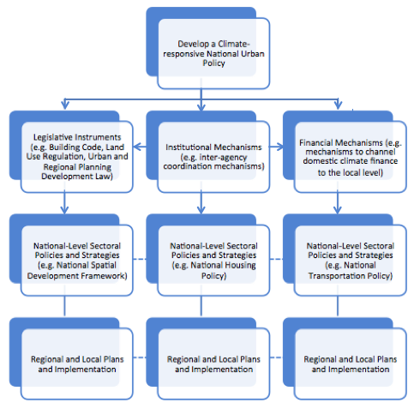
What is Mainstreaming?
Forms of Mainstreaming
Mainstream climate change into National Spatial Development Framework
National Transportation Policy
National Infrastructure Policy
Coastal Zone Policy
National Housing Policy
Systemic Mainstreaming
Specific Mainstreaming
Notes:
What is meant by “mainstreaming”?
In the context of climate change, mainstreaming can be defined as a process where current policies, strategies and plans, as well as the legal, financial and institutional frameworks that support these are reviewed and expanded to integrate climate change mitigation and adaptation considerations.
For example, the Philippines Climate Change Act of 2009 has defined mainstreaming as “the integration of policies and measures that address climate change into development planning and sectoral decision-making”. In particular, this includes introducing climate change responsive language in planning, determining and measuring climate change related indicators, and introducing climate change responsive actions.
As discussed earlier, national-level urban-related policies take various different forms, and are at different levels of development across countries in the Asia Pacific region. Different entry points to mainstreaming can be considered depending on the country’s current situation with regards to urban policy development.
Systemic Mainstreaming, as shown in the diagram on the left may be suitable for countries that already have an integrated national-level policy framework, such as a National Urban Policy (NUP) in place to orient urban development – or for countries that wish to newly develop a NUP. By mainstreaming climate change into this overarching policy, it can facilitate the process of subsequent systematic mainstreaming into sectoral policies, strategies, and legislative, institutional and financial mechanisms that fall under this framework.
Sectoral Mainstreaming seeks an entry point for mainstreaming of climate change into one sectoral policy, perhaps taking advantage of a specific driver for mainstreaming such as a funding opportunity. The sector into which climate change was mainstreamed may then advocate and expand the mainstreaming process to other urban sectors, serving as a blueprint.
In addition to the systemic and sectoral approaches that are anchored at the national level as introduced above, some countries have started their mainstreaming process from the local level. For example, Myanmar piloted climate change vulnerability assessments and local action planning processes in two townships. This process was then integrated into the National Climate Change Policy, Strategy and Action Plans, with the goal of replicating the format in all 330 townships of Myanmar.

Slide 13
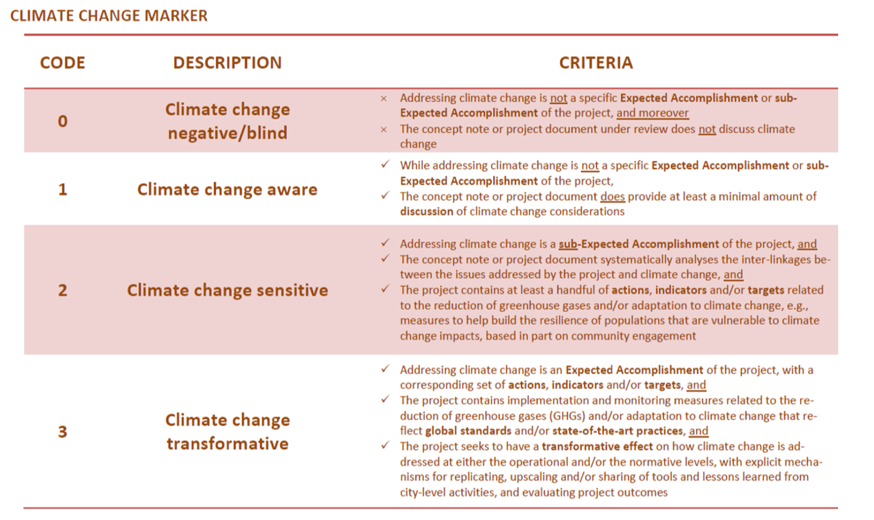
Degrees of Mainstreaming
Notes:
Another question to be considered is the desired “degree” or depth of mainstreaming that is appropriate in the country context. For example, the UN-Habitat Climate Change Marker differentiates between the following three degrees:
Climate Change Aware: While specific actions and targets with regards to climate change may not be incorporated, there is a minimal amount of discussion pertaining to climate change considerations.
Climate Change Sensitive: The inter-linkages between the issues addressed and climate change are systemically analysed, and specific actions, and targets and /or indicators related to the reduction of greenhouse gases, and adaptation to climate change impacts are incorporated.
Climate Change Transformative: Avoidance or reduction of a climate change cause or impact is an expected accomplishment, with a corresponding set of actions, targets and /or indicators that reflect global standards and best practices. There is a transformative effect on how climate change is addressed at either the operational or normative levels, with explicit feedback and learning loops, and monitoring and evaluation mechanisms in place.

Slide 14



Cross-Cutting Issues
Youth
Gender
Human Rights
Notes:
Whether a new climate-responsive NUP will be developed or climate change considerations will be mainstreamed into an existing national-level urban-related policy, the mainstreaming of climate change is a good opportunity to consider other issues and principles such as gender, human rights or pro-poor development, which can be mainstreamed simultaneously.

Slide 15
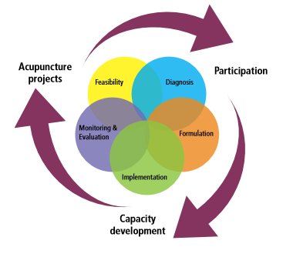
Mainstreaming Framework
Four “Phases”
Phase A: Feasibility and Diagnosis
Phase B: Formulation
Phase C: Implementation
Phase D: Evaluation
Phases and Pillars of the National Urban Policy Process
Source: National Urban Policy: A Guiding Framework, p. 10
Notes:
The next two slides present the Mainstreaming Framework introduced in Section 2 of the guide.
The Framework takes the form of a matrix with four mainstreaming Phases of A: Feasibility and Diagnosis, B: Formulation, C: Implementation, and D: Evaluation, and four mainstreaming Elements of 1) Substantive process, 2) Resource and capacity assessment and development, 3) Urban and climate related policy alignment, and 4) Institutions and stakeholders. The Framework allows users to pick tasks in relevant building blocks across Phases and Elements and helps them design their country and time specific mainstreaming process.
The Phases are aligned with those of the UN-Habitat National Urban Policy process, which is introduced in the publication “National Urban Policy: A Guiding Framework”. For users that are developing a new National Urban Policy from scratch, this mainstreaming framework can be used in conjunction with the other NUP tools.
The result of the mainstreaming process will be the formulation, adoption and implementation of a coherent policy framework with climate change concerns integrated into relevant urban policy elements (e.g. key principles, sectoral chapters, action areas etc.), depending on each country’s unique context.

Slide 16
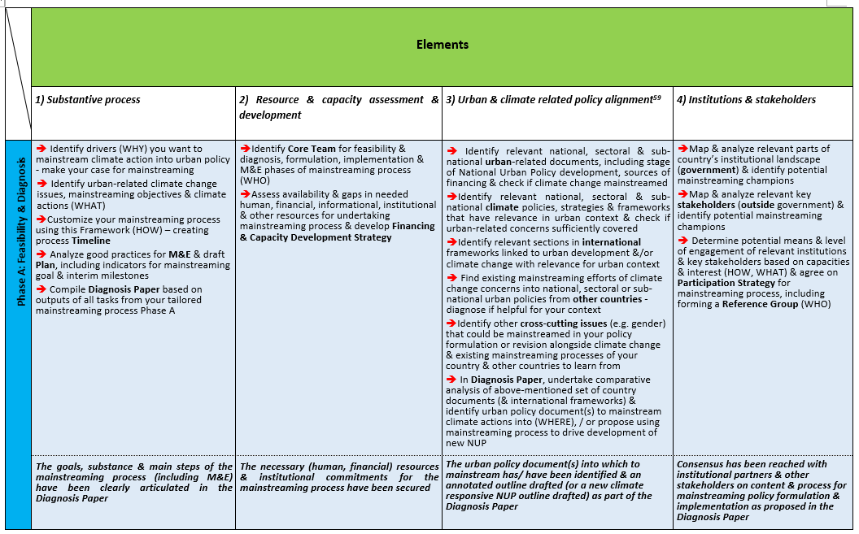
Framework Overview Table
Notes:
The Overview Table on the two-page spread the middle of the Regional Guide gives a snapshot of the Framework in its entirety. This figure shows a portion of the framework under Phase A: Feasibility and Diagnosis.
A brief explanation of the Elements:
1) Substantive process - This Element focuses on identifying the drivers for mainstreaming climate change into national urban policies; identifying and analysing the issues, objectives, actions that will be mainstreamed; and zooming in on the ‘HOW’ of the mainstreaming process - mapping it out, creating a framework for monitoring and evaluation, drafting the text, and pushing for implementation.
2) Resource and capacity assessment and development - This Element assists with mapping out and analysing available and needed resources and capacities, and planning all practical and logistical aspects of the mainstreaming process. It involves conducting capacity gap assessments and planning and undertaking capacity development activities. Under this Element you receive guidance on creating detailed work plans, and supporting resource mobilization for implementation of mainstreaming, as well as for subsequent climate actions.
3) Urban and climate related policy alignment – This Element assists with identifying and analysing all key international, national and sub-national urban- and climate-related policies, strategies and frameworks, as well as relevant legislative instruments, so that the mainstreamed national urban policy makes correct and complete references and embeds necessary mechanisms of coordination and implementation, including financing.
4) Institutions and Stakeholders - All key government institutions with urban- and climate-related mandates are identified and analysed, so that the mainstreamed national urban policy makes the right references and considers linkages and mechanisms of coordination and implementation. The needs, mandates and resources of these institutions should be considered. Also, key actors outside government should be identified, such as civil society, community organizations, academia, business, professional associations etc. and their needs, roles and resources should be considered.

Slide 17
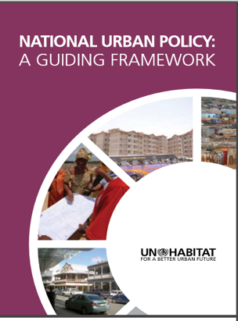
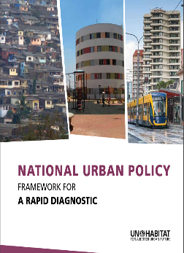
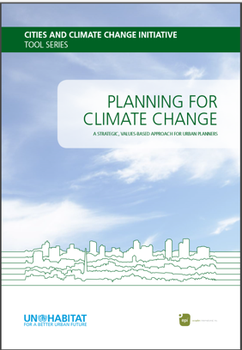
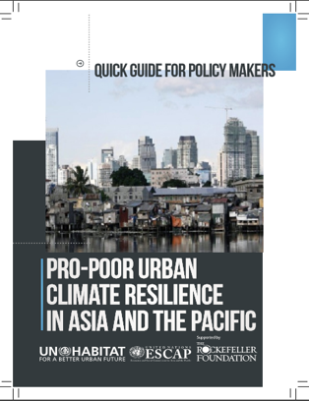
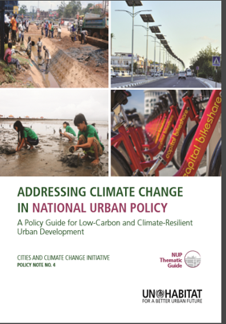
Publications That Supplement the Guide
Notes:
These are some publications that can be used in conjunction with the Regional Guide. Box 1 in the Regional Guide provides a description of these publications and how they can be used.

Slide 18
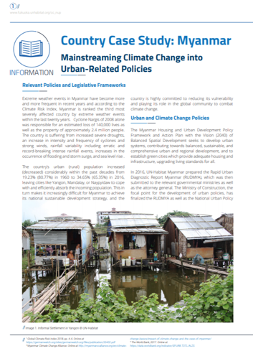
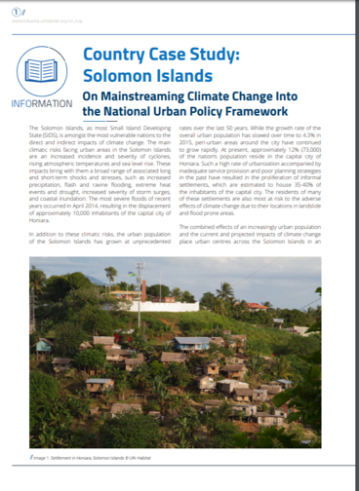
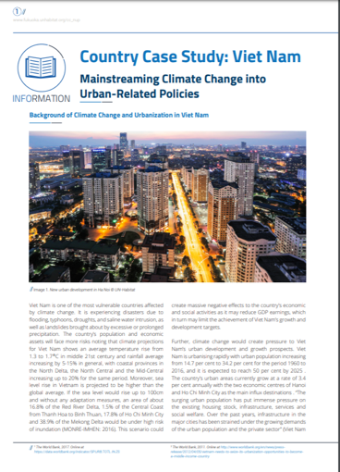
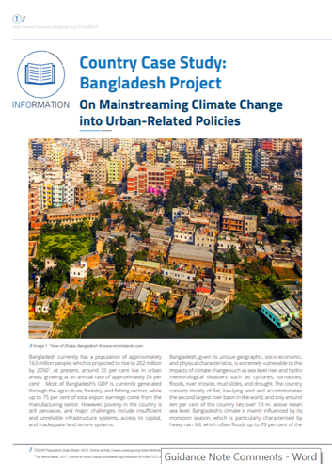
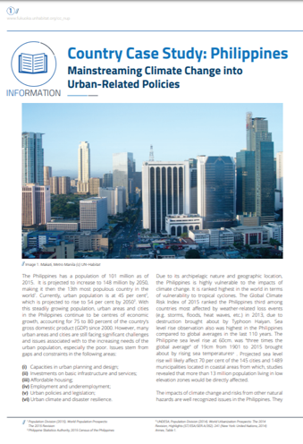
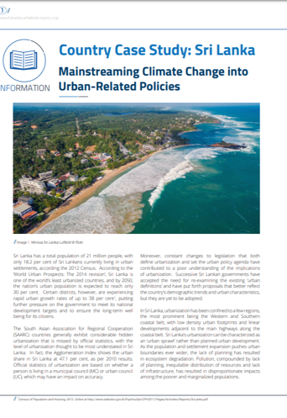
Country Case Studies
Notes:
The Regional Guide is further supplemented by a series of Country Case Studies which present the process and current state of mainstreaming in six different countries: Bangladesh, Myanmar, Philippines, Solomon Islands, Sri Lanka and Vietnam.

Slide 19
Section 2 – Introduction to the Tools and Scenarios
Notes:
The Guide and Framework was conceptualised to be used in conjunction with a set of Tools and Scenarios, shown on the next slides. There are 13 tools, consisting of additional information and training materials specifically prepared to accompany the guide.

Slide 20
Overview of Tools
Tool | Type | Description
Framework Tasks (TT) | Planning & reference | Provides a detailed explanation of each task in the framework, guiding questions and other information sources.
Making the Case (MC) | Strategy | Identifies entry points for mainstreaming, the drivers, and motivation for the climate change mainstreaming process.
Climate Change Concepts (CC) | Reference | Summarises and explains the main terminology linked to climate change, disaster risk reduction and management.
Climate Issues to Actions (IA) | Consultation & prioritisation | Identifies climate change issues to be converted into mainstreaming objectives and potential policy solutions against the issues identified.
Climate Finance (CF) | Reference | Outlines the international and domestic sources of and mechanisms for financing climate action and how these can be linked to urban related climate actions.
Notes:
Framework Tasks (TT) is a reference tool to be used throughout the process with more detailed explanation of each task in the framework, guiding questions and other information sources. Helps to create a process timeline with individual tasks that can be customised according to country-context.
Making the Case (MC) assists in identifying entry points for mainstreaming, the drivers, motivation for climate change mainstreaming process.
Climate Change Concepts (CC) summarises and explains main terminology linked to climate change, disaster risk reduction and management and provides reference to further materials.
Climate Change Issues to Actions (IA) helps to identify climate change issues that can be converted into mainstreaming objectives and potential policy solutions against issues identified.
Climate Finance (CF) outlines international and domestic sources of and mechanisms for financing climate action and how these can be linked to urban related climate actions.

Slide 21
Overview of Tools
Tool | Type | Description
International Frameworks (IF) | Reference & strategy | Introduces key international frameworks and how they link to urban climate issues.
Good Urban Governance (UG) | Evaluation | Characterises different dimensions of good urban governance and how it can be brought into the formulation of the urban policy.
Stakeholder Analysis (SA) | Evaluation & strategy | Identifies the important government and non-government stakeholders to engage.
SWOT (SW) | Evaluation | Assesses availability and gaps in human, financial, informational, institutional and other resources, along with capacity constraints.
Selecting Indicators (SI) | Evaluation | Defines indicators for the mainstreaming process and helps identify and formulate effective policy mainstreaming objectives and climate actions.
Drafting Your Diagnosis Paper (DP) | Strategy & evaluation | Assists in preparing the structure and content of the Diagnosis Paper and eventually the policy proposal.
Notes:
International Frameworks (IF) provides an introduction to the key international frameworks and how they link to urban climate issues, particularly the targets and indicators, review and reporting mechanisms and capacity development or finance linkages.
Good Urban Governance (UG) characterises the different dimensions of good urban governance and how it can be brought into the formulation of the urban framework policy. Together with the SWOT Analysis tool can provide an initial assessment of institutional capacity.
Stakeholder Analysis (SA) helps to identify important government actors and non-government stakeholders to engage considering why each is needed to make it a success, why they would be interested and what kind of support they need to participate and successfully implement the policy.
SWOT (SW) helps to assess the availability and gaps in human, financial, informational, institutional and other resources, as well as capacity constraints and evaluating existing policies and documents vis a vis climate responsive urban development.
Selecting Indicators (SI) assists with defining indicators for the mainstreaming process and identifying and formulating effective mainstreaming objectives and climate actions for the policy itself.
Drafting Your Diagnosis Paper (DP) assists in preparing the structure and content of the Diagnosis Paper and eventually the policy proposal.

Slide 22
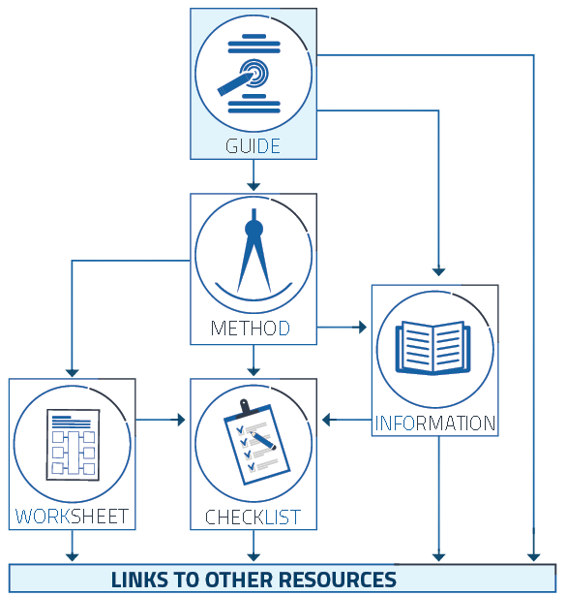
Overview of Tools
Notes:
Each of the Tools are divided into ‘METHOD DESCRIPTIONS’ that explain the objective of a tool, how to use it, and under which tasks in the Mainstreaming Framework it can be used. Some tools have a ‘TEMPLATE’ and ‘CHECKLIST’ that guide the user through the steps of the method, providing specific assistance on how to implement the various Tasks of the Framework. Some tools further include ‘INFORMATION SHEETS’ with more detailed explanations on various subjects introduced in the tool and/or Guide.

Slide 23
Flowchart of Tools and Linkages
Notes:
This flowchart demonstrates the linkages between each tool and their respective inputs and outputs towards Drafting the Diagnosis Paper, which is the main output of the mainstreaming process and feeds directly into the Climate Change Policy Proposal.

Slide 24
Using the Flowchart
Notes:
As explained earlier, the Framework Tasks Tool forms the overarching component of the mainstreaming process, describing each of the tasks in detail and supporting the customization of your country’s unique mainstreaming process.
The Making the Case Tool is a good starting point in any scenario, as it can assist in identifying entry points for mainstreaming, the drivers, motivation for your climate change mainstreaming process. From here, at least two distinct approaches can be identified to launching the process.
① Firstly, and more strategically, is to start by assessing the climate or urban policies, agreements and actions already in place through the SWOT Analysis Tool, helping to identify the important gaps and opportunities for actions to be examined more closely with the Issues to Actions Tool. The Stakeholder Analysis and Good Governance Tools can provide important inputs as well as outputs here by considering the institutional setup, structures and key stakeholders which may present opportunities or barriers towards collaboration and policy implementation.
②Secondly, taking a more bottom-up and open-ended approach is to begin with the Issues to Actions Tool from identifying climate change issues known on the ground through practical experiences, which can then be turned into actions and integrated into existing commitments and policies.

Slide 25
Using the Flowchart
Notes:
In either case, objectives and actions identified using the Issues and Actions Tool must be measurable with baselines and targets in order to ensure progress is made towards meeting them.
The Selecting Indicators Tool is therefore important to consider at this stage to define indicators for the mainstreaming objectives and actions; and should link to International Frameworks where possible as these provide recognised monitoring and reporting mechanisms at the country-level, with the Climate Finance Tool helping to identify realistic national and international funding options for the actions.
Once the diagnosis paper is built with inputs from the selected activities described above, this can feed directly into the Climate Change Policy Proposal, its implementation and mainstreaming across different sectors within the NUP.

Slide 26
Example Scenarios
An existing National Urban Policy is in place but is undergoing revision or updating (c.f. Philippines Country Case Study):
  Reviewing existing national and international climate change policies
  Considering city contexts and vertical integration of concerns
  Encouraging dialogue and exchanges between stakeholders
  Challenging siloes and taking a system rather than a sectoral approach
Tools to use as entry points: Making the Case, SWOT Analysis, Stakeholder Analysis
Notes:
Certain tools will provide better entry points than others depending on your country’s unique scenario, and therefore the approaches presented in the flow chart are merely provide generic guidance. The examples presented in the following slides describe some specific scenarios or situations which your country may fall under, especially where some existing climate or urban legislation and actions already exist.

Slide 27
Example Scenarios
2. There are urban-related policy documents but no overarching framework to link them together (c.f. Bangladesh Country Case Study):
  Reviewing policy and legislation and conducting analysis of stakeholders
  Importance of capacity building and good governance to improve coordination and integration and clearly define responsibilities
  Climate change can provide an important link and motivation among stakeholders for a comprehensive policy
Tools to use as entry points: Making the Case, SWOT Analysis, Stakeholder Analysis, Good Urban Governance

Slide 28
Example Scenarios
Local or city-level climate actions are ongoing but with limited or no integration into National Urban Policy (c.f. Solomon Islands Country Case Study):
  Local level actions such as vulnerability assessments can inform and start the mainstreaming process directly, providing a sense of the issues on the ground which can be incorporated into resilience plans and scaled-up in national policy
  Importance of capacity building of officials and integrating sectoral policies into NUP that can assist with vertical integration
Tools to use as entry points: Making the Case, Issues to Actions, SWOT Analysis, Stakeholder Analysis

Slide 29
Example Scenarios
4. There is a strong national level climate focus but little local level action and integration into urban policy (c.f. Sri Lanka, Vietnam Country Case Studies):
  Capitalising on existing stakeholders and mechanisms for cooperation across sectors
  Building the understanding and appreciation of climate impacts on the urban sector through capacity building
  Considering existing good practices/initiatives/plans/policies at the local level and how these could be scaled-up with reference to international frameworks to increase buy-in
Tools to use as entry points: Making the Case, Stakeholder Analysis, Good Urban Governance, International Frameworks

Slide 30
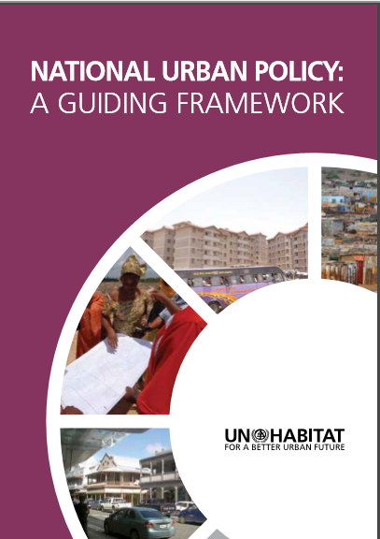
New National Urban Policy
Notes:
Where an NUP is not yet developed, climate change may become one of the drivers to push for one, with the UN-Habitat published National Urban Policy: A Guiding Framework and National Urban Policy: Framework for a Rapid Diagnostic guides providing useful references to begin the process.

Slide 31
Section 3 – Next Steps
Notes:
Moving forward beyond the higher-level overview of the process provided by this presentation, there are several next steps to consider when planning for and customising your mainstreaming process.

Slide 32
Next Steps
Review the Main Guide and Guidance Note in detail
Establish your ‘Core Team’ and begin assigning roles and responsibilities
Identify your entry point based on the Scenarios and Framework. Begin to plan how the process will proceed
Consider initial resource and capacity gaps and requirements
Notes:
If you have not already done so, a detailed review of the Main Guide and associated Guidance Note is recommended before embarking on the process, providing more detail and clarification to the points raised in the presentation.
You should establish a Core Team to manage the mainstreaming process from start to finish. This may consist of existing policymakers and urban or climate change specialists from one or more government entities depending on your country’s circumstances. They should have the authority and mandate to drive the process through, with clearly defined roles and responsibilities to avoid potential conflict.
Using the Scenarios presented and the Framework Tasks Tool, the Core Team can then identify the country’s entry point and assess what Tasks might already have been completed. This helps to plan and map out the entire process, determining which Tasks and Tools to use and in what order, creating a Process Timeline like the one shown at the bottom of the slide.
Resource and capacity needs are also important to consider at this stage and throughout the process, as it is both time and labour intensive. An initial gap assessment of the human, technical, financial and informational capacities and constraints of the Core Team against the identified Tasks using the SWOT Tool or similar can assist with this. Any gaps or needs highlighted can be included in a Financing and Capacity Development Strategy to mobilise additional expertise and resources.

Slide 33
Thank you for your attention!
UN-Habitat
UNESCAP
www.fukuoka.unhabitat.org/cc_nup

